Slide 1
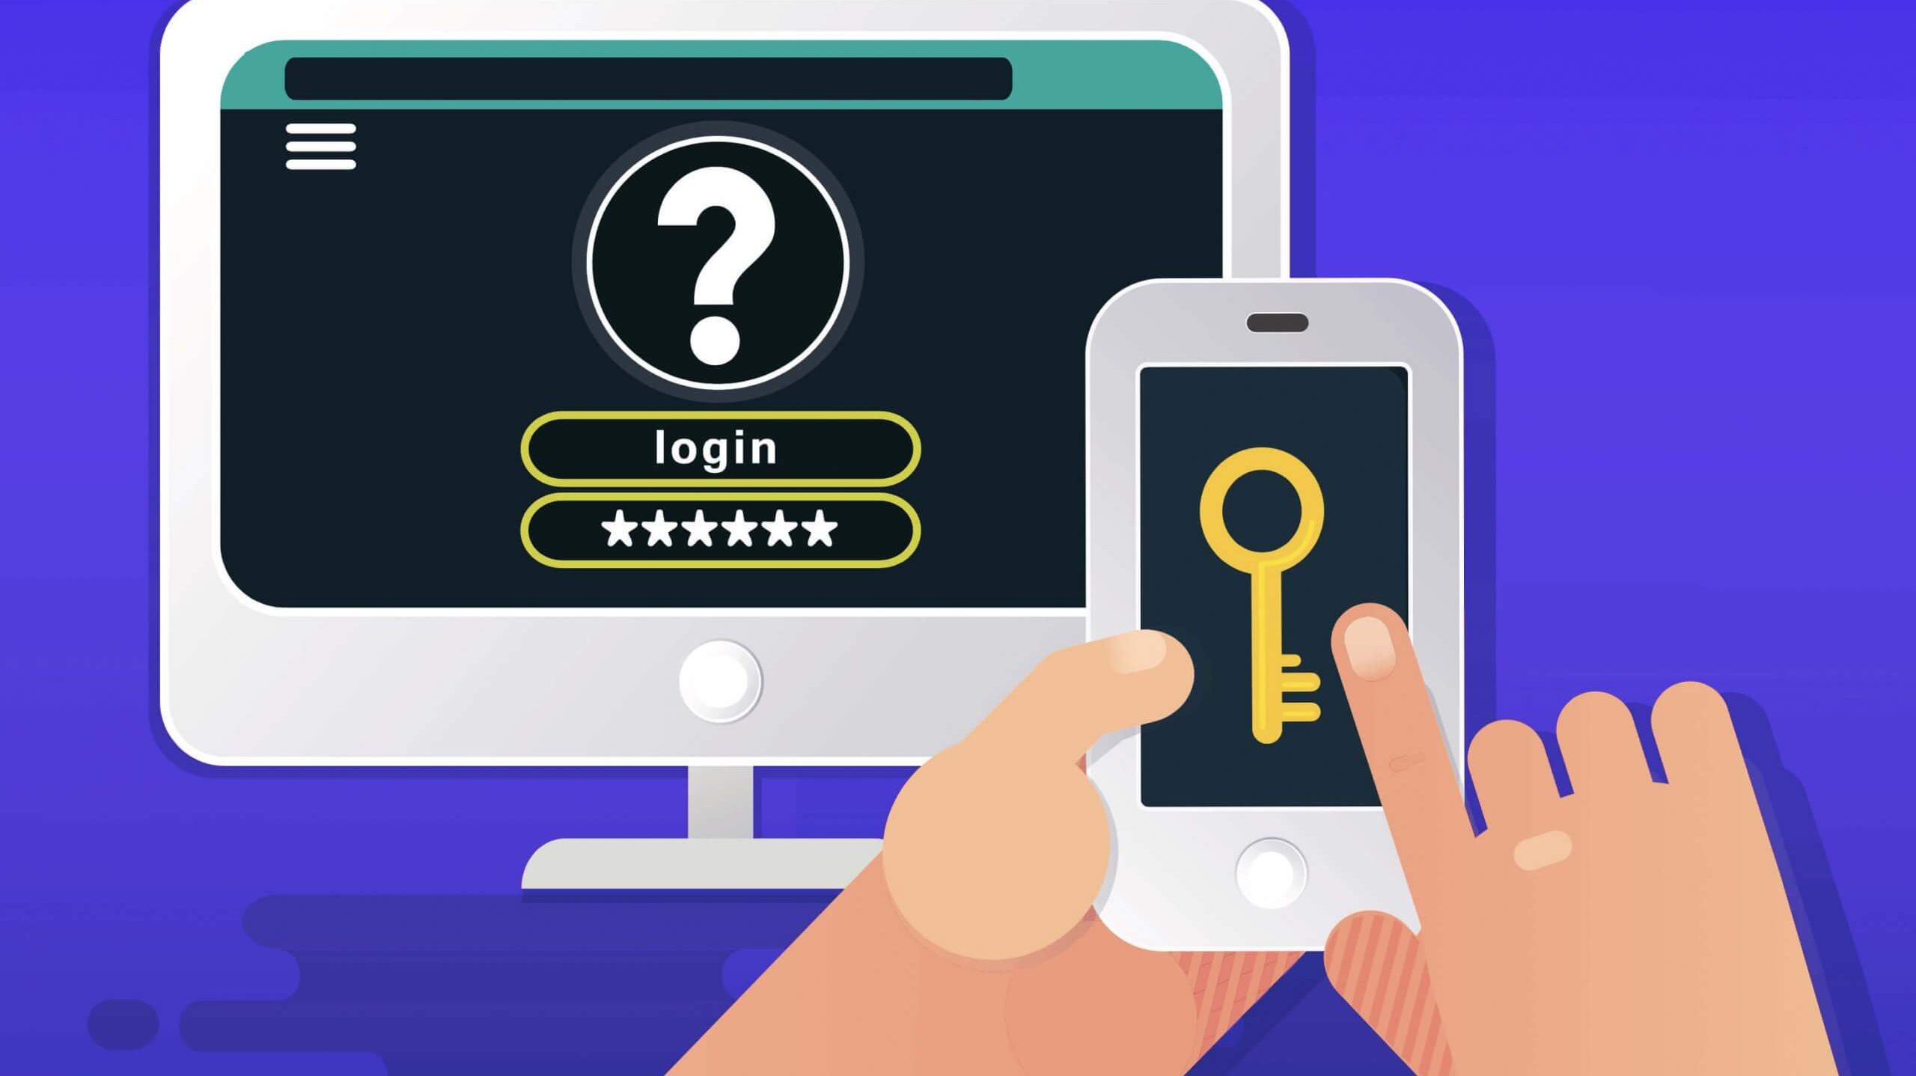
Authentication

Slide 2
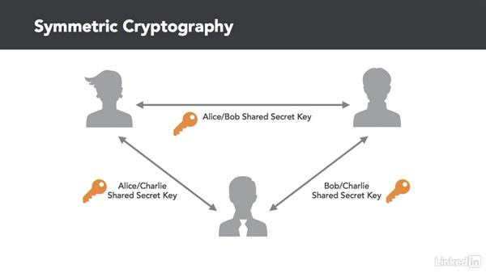

Slide 3
Interlock Protocol
Alice and Bob exchange public keys…
They encrypt messages for each other.
They send half, validate it with the keys.
They send the other half, validate it.
They reassemble and decrypt the message.

Slide 4
User Lifecycles
There is a whole lot of processes that need to be performed to even get to the point where we can ask ourselves how to securely communicate between individuals.

Slide 5
Request
Entitlements
Recertification
Termination
Account
Lifecycle

Slide 6
Account provisioning
Ideally, one account per user in your organization is best. Perfect accountability and maximum ability for access control.
Communal accounts collectivize access control but obliterate accountability.
Single accounts maximize accountability but prevent granularity in access control.
Not all users will be members of your organization, and vendors/contractors will have competing agendas.
Not all users will be actual people.

Slide 7
Identity proofing
The purpose of authentication is to ESTABLISH and VERIFY a user’s identity.
Establishing identity means identity proofing. Before credentials are issued, the user presents some proof of their identity.
Verifying means presenting those credentials along one of several factors.
Not all “users” will have an identity

Slide 8
Multi-factor
Something you have (key, card, OTP token)
Something you know (passwords, shibboleth)
Something you are (biometrics)
As we saw yesterday, machine accounts can do this as well with machine profiles (something it is.) But this doesn’t verify the user, it verifies the system.
Using the same factor multiple times is NOT MFA. Ex. Two passwords

Slide 9
User / entitlement Repositories
Ideally, all users and their entitlements would be kept in a single repository.
Not all products integrate with every system.
Not all systems can be connected to the central repository.
There are some Identity Service out there that will attempt to manage this, but the best defense is a soldi Identity and Access Management plan and documentation.

Slide 10

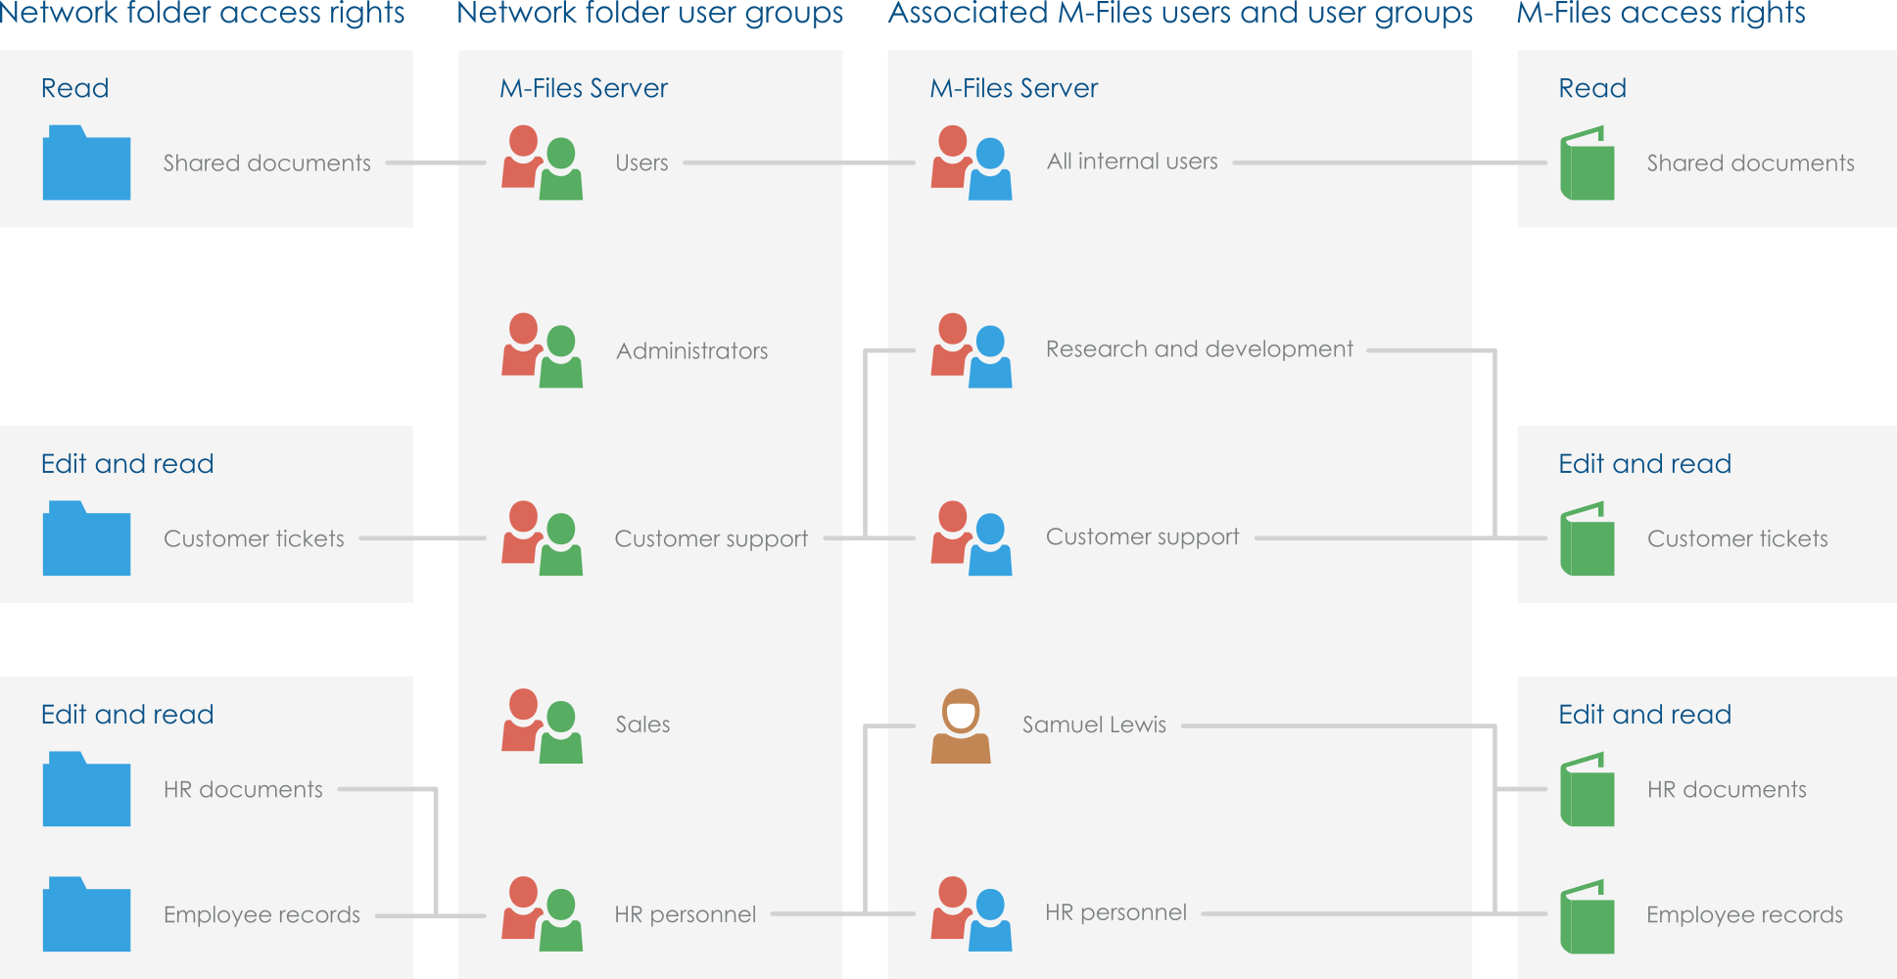

Slide 11
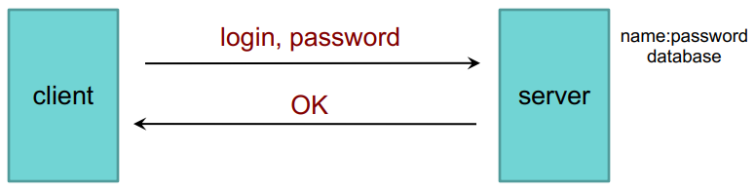
Password Authentication Protocol (PAP)
Password files or databases must be protected from open access, as there is one point of validation.
Hashing provides some protection, but as we often see this is not enough.

Slide 12
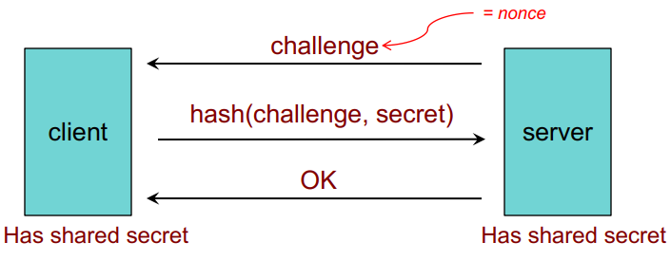
Challenge-Handshake Authentication Protocol (CHAP)
Provides two-way verification to ensure the server is trusted by using a NONCE

Slide 13
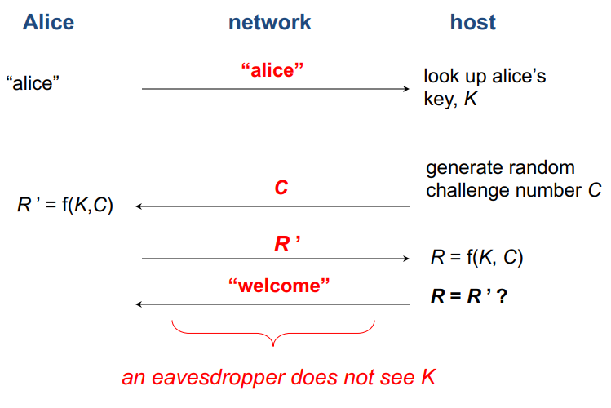

Slide 14
Time-Based One-TimE Password (TOTP)
As we discussed yesterday, a modern version of a one-time pad.
Both sides share a key.
A function generates a one-time password based on the hash value of that key and some other seed (usually time.)
If they match, that validated on the factor of possession of a trusted object.

Slide 15
Public Key Authentication
Alice
Alice
Bob Trusts Alice
Alice Trusts Bob
Key Repo
Private Key
Key Repo
Nonce
Public Key
Public Key
Nonce
Private Key
Bob
Bob

Slide 16
What is a public and private key?
In RSA, a simple formula is used to produce a pair of numbers at output. If the input is kept secret, so are those results. All we need is a pair of prime numbers (p and q.)
Modulus: N = p *q
r = (p-1)*(q-1) (Our keys will be a factor of 1 mod r)
K = A result of 1 mod r with can be factors.
e and d = Two of those factors.
e,N is our public key. d,N is our private key.

Slide 17
What is a public and private key?
This is why maintaining secrets is important. We can freely give out e as long as the other figures remain secret, otherwise we could derive the keys. In this case, this is very weak, using only two-bit key.
Because e,N is our public key if we know e and N we can reverse RSA. We just need to factor N.
N has two factors, 3 and 29. That’s p and q and that’s all we need to derive both public and private keys, and since we know e we can more easily identify d.
Go ahead and try it… e = 11, N = 143

Slide 18
X.509 certificates
Alice and Bob Trust the CA
CA
Public Key
Alice
Bob
Cert + Public Key

Slide 19
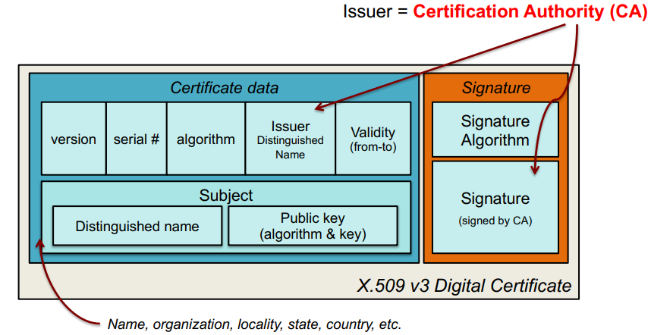
x.509 certificates

Slide 20
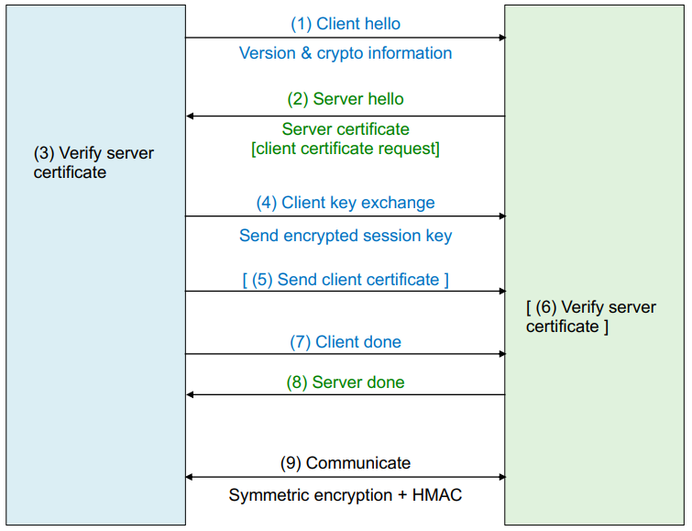
TLS Authentication
In order to use this for authentication we need to figure out how to exchange secrets securely. This is done via Key Agreement or Key Exchange.
This is a HYBRID CRYPTOSYSTEM where authentication is done by on method and communication with another.

Slide 21
Key Exchanges
Auth and key exchange methods together are known as a CIPHER SUITE. An example:
TLS_ECDHE_RSA_WITH_AES_128_GCM_SHA256
Key exchange will be done with ECGHE (Ephemeral Eliptic Curve Diffie Hellman)
Certificate will contain and RSA public key.
The symmetric cipher used after exchange will be AES-GCM with a 128-bit key.
The PRF (Pseudo-Random Function) used in the exchange will be SHA256.

Slide 22
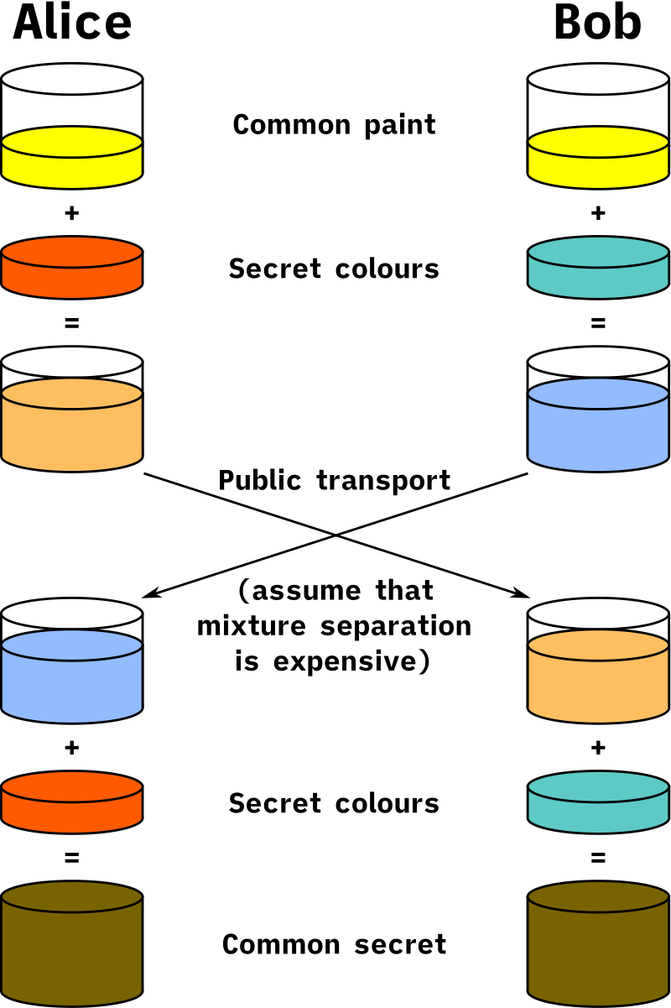
Key exchanges – Diffie Hellman
Alice and Bob agree on an arbitrary color, which should be different each time they communicate.
Each of them has a secret color as well.
Mixing the colors produces a new color, which they send to each other.
They ad their own secret color to the new color, producing a final color that should be identical since they mixed in the same colors in the same amounts, just in different orders.
A = 5, B = 3, C = 4. A+B=8, A+C=9. 9+B=12. 8+C=12

Slide 23
Key Exchanges: Ephemerality
Key exchanges that utilize ephemerality are known as having “forward secrecy” because it generates a new random DH-key pair each connection, so even if a session is compromised future and past sessions are not.

Slide 24
Auth types: Local and Direct
Endpoint
Server
User/Pass
User
User/Pass

Slide 25
Auth types: Session/Cookie
User/Pass
Endpoint
Server
Cookie/Session ID
Request + Cookie/Session ID
User/Pass
User

Slide 26
Auth types: Kerberos - KDC
KDC
(Authentication Service and TGS)
2. User/Long-Time Key ->
<- Session Key / TGT
4. Service Key
Session Key is encrypted with the Long-Time Key, derived from the user’s password so only the KDC and local Kerberos client can decrypt it.
Session Key is temporary, stored in volatile memory, and has a TTL value.
Endpoint
Server
3. Request to access Server A, Session Key, Timestamp ->
<- Service Key
1. User/Pass
4. Service Keys decrypted, and connection established.
User

Slide 27
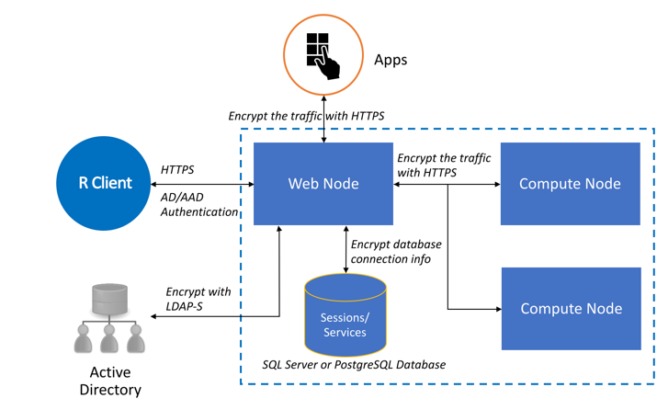
Lightweight Directory Access Protocol (LDAP)

Slide 28
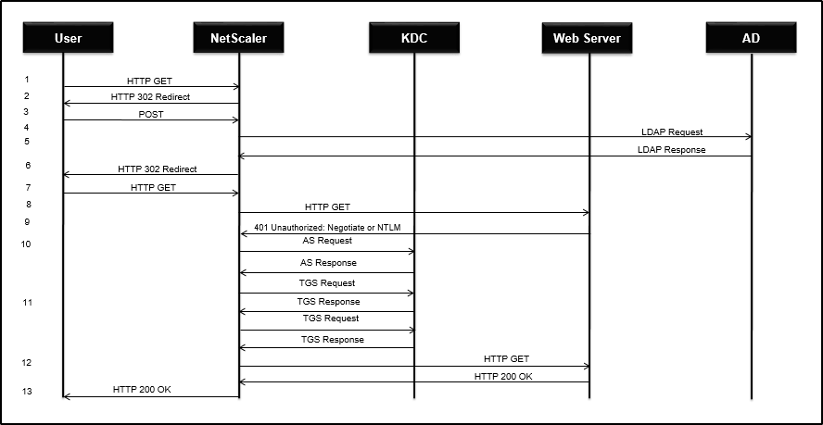

Slide 29
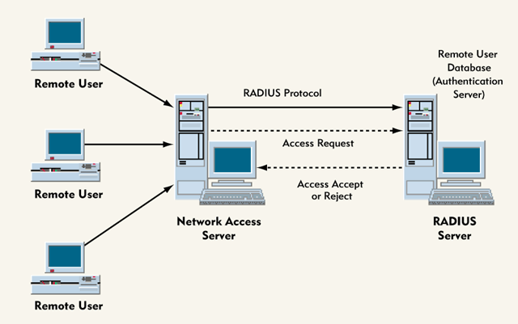

Slide 30
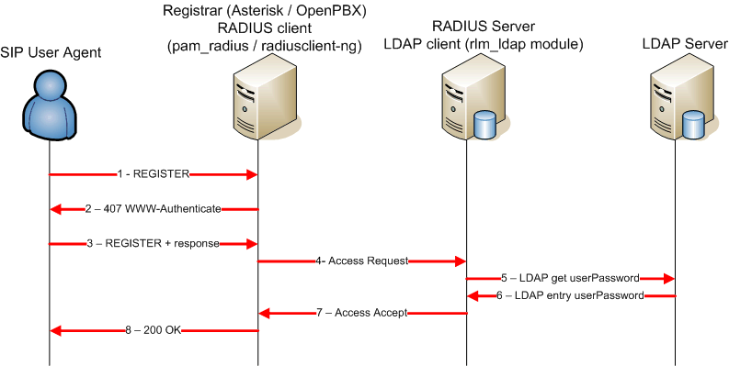

Slide 31
Auth Types: HTTP types
Basic authentication
In Basic access authentication, the client provides a username and password when making a request, which is sent in an Authorization header. The username and password are concatenated into a single string username:password which is encoded in Base64, and written with the Basic keyword before the encoded string "Authorization: Basic am9objpzZWNyZXQ=" example.com.
Bearer authentication
Bearer authentication, also called token authentication is a HTTP authentication mechanism that makes use of cryptic strings (called Bearer Tokens). Bearer Tokens are generated by the server during a login request, and similarly to basic authentication, the token is sent in an Authorization header - with the Bearer keyword.

Slide 32
Auth Types: HTTP types
Digest authentication
In Digest authentication, all the user credentials (usernames and passwords), HTTP methods and requested URIs are encrypted using MD5 (message-digest algorithm) hashing before being sent to the server. However, the digest access authentication mechanism is still vulnerable to man-in-the-middle attacks.
Form-based authentication
In Form-based authentication, the user credentials (username and password) are sent in a plain text (like Basic authentication) using forms, which can lead to exposure of usernames and passwords except connecting via HTTPS/SSL. One benefit is that, the developer is allowed to customize the authentication and error pages sent by the browser.

Slide 33
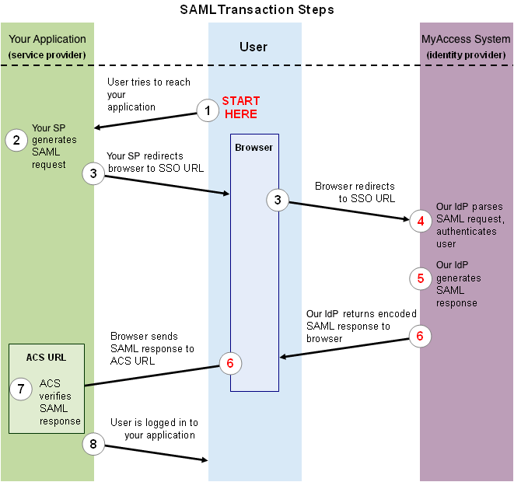
Auth types: Security Assertion markup Language (SAML) – AkA. Shibboleth, AKA. Claims-Based Auth
Notes:
When the soldier said "no," he was asked to say "shibboleth" (which means "stream" in Hebrew). Gileadites pronounced the word shibboleth, but Ephramites said "sibboleth." Anyone who left out the initial "sh" was killed on the spot.

Slide 34
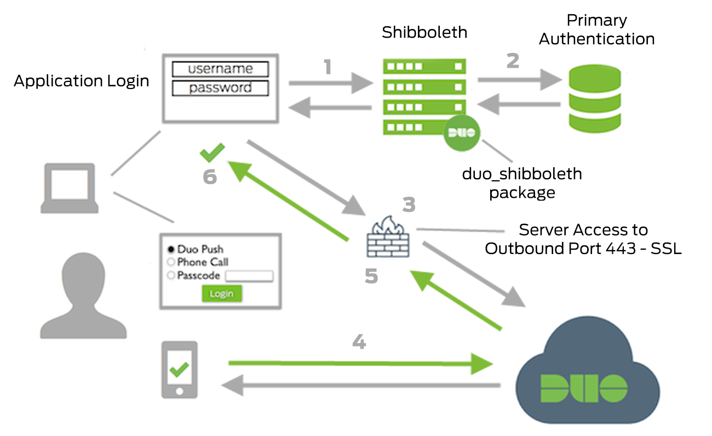

Slide 35
